Slide 1

VIRTUAL REALITY VISUAL FIELD TESTING DEVICE
Caleb Mok Kah Hou 2689719m

Slide 2

Outline
Introduction
Design
Implementation
User Study
Results
Conclusion

Slide 3

Introduction
This project introduces a VR-based visual field testing (VFT) system built using consumer-grade VR hardware with eye tracking.
The aim is to offer a flexible, low-cost, and extensible alternative to traditional clinical perimetry tools.

Slide 4

Why do all this?

Slide 5
Motivation
Early-stage visual defects are hard to notice without proper testing.
Missed diagnoses can lead to severe consequences:
- loss of independence, employment, and quality
of life.
Traditional perimetry systems are expensive and not widely accessible.
VR enables immersive environments for VFT that is much cheaper and portable.
An open-source software reduces barriers and promotes innovation, especially in low-resource or academic settings.

Slide 6
Aims
Goal: Build a VR-based visual field-testing platform as a practical, affordable alternative to traditional perimetry.
Approach: Uses consumer VR with eye tracking to tackle cost and accessibility issues.
Prototype Capabilities:
Displays randomised visual stimuli in VR
Records responses
Logs data for analysis
Generates PDF report
Impact: Aims to support early detection of vision loss, with strong potential for use in remote or resource-limited settings.

Slide 7
Design

Slide 8
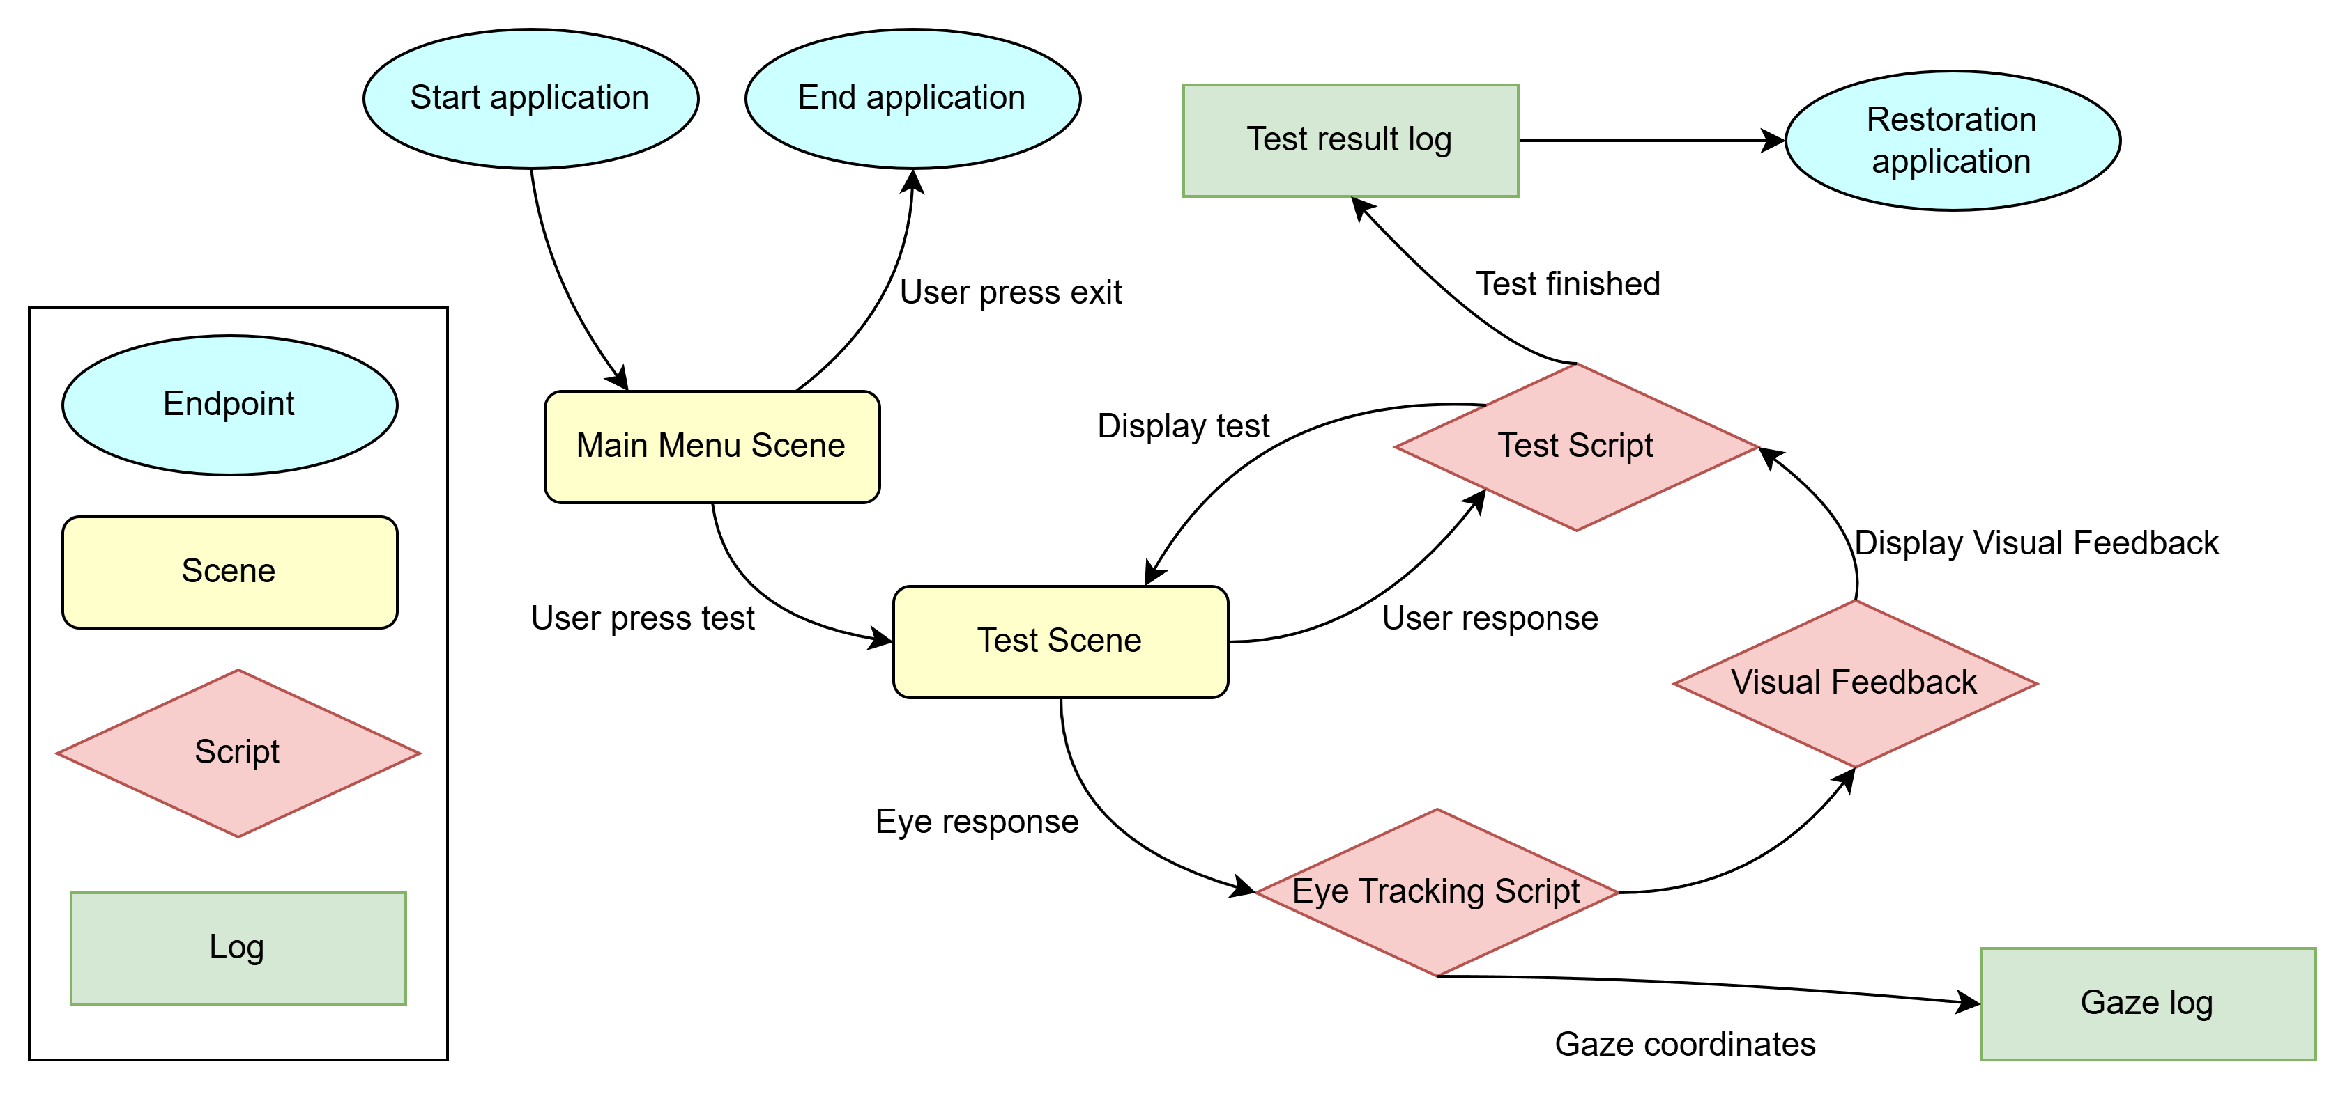
Overview
Workflow:
Session Initialisation​
Main Menu Navigation​
Pre-Test Countdown​
Stimulus Generation​
Fixation Monitoring & Feedback​
User Response Logging​
Test Completion & Data Export
Report Generation

Slide 9
Repeated Fixed Intensity Strategy
Instead of using complex thresholding algorithms like SITA, we implemented a non-threshold strategy based on fixed-intensity stimuli.
Due to hardware limitations preventing absolute brightness calibration on VR headsets, we used a single consistent brightness level for all stimuli.
Each stimulus is shown multiple times at each test point in a randomized order.
Participants indicate whether they see each flash, and the system classifies each location as:
Consistently Seen – detected more than 3 times
Inconsistently Seen – detected 1–2 times
Unseen – 0 detections
Simple and robust method, ideal for preliminary screening, when full sensitivity data isn't needed.

Slide 10
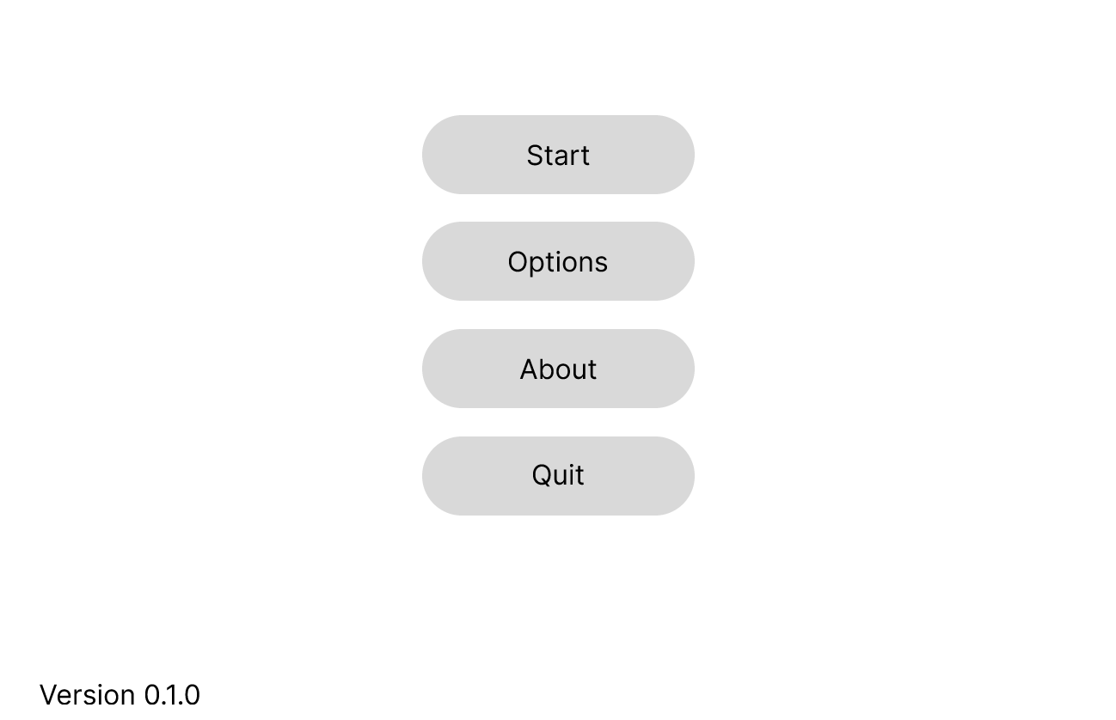
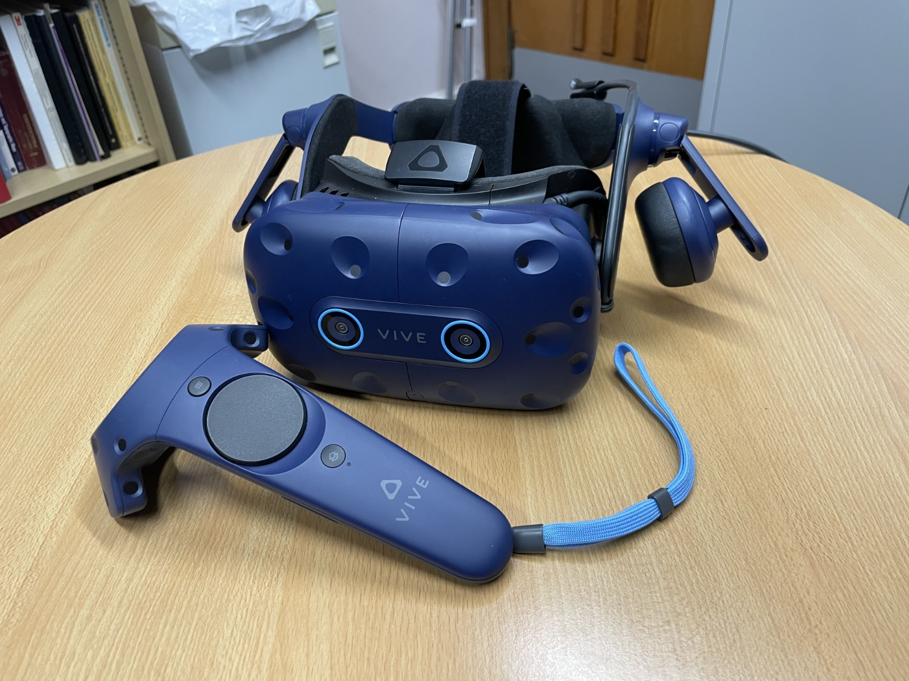
User Interfaces and Inputs

Slide 11
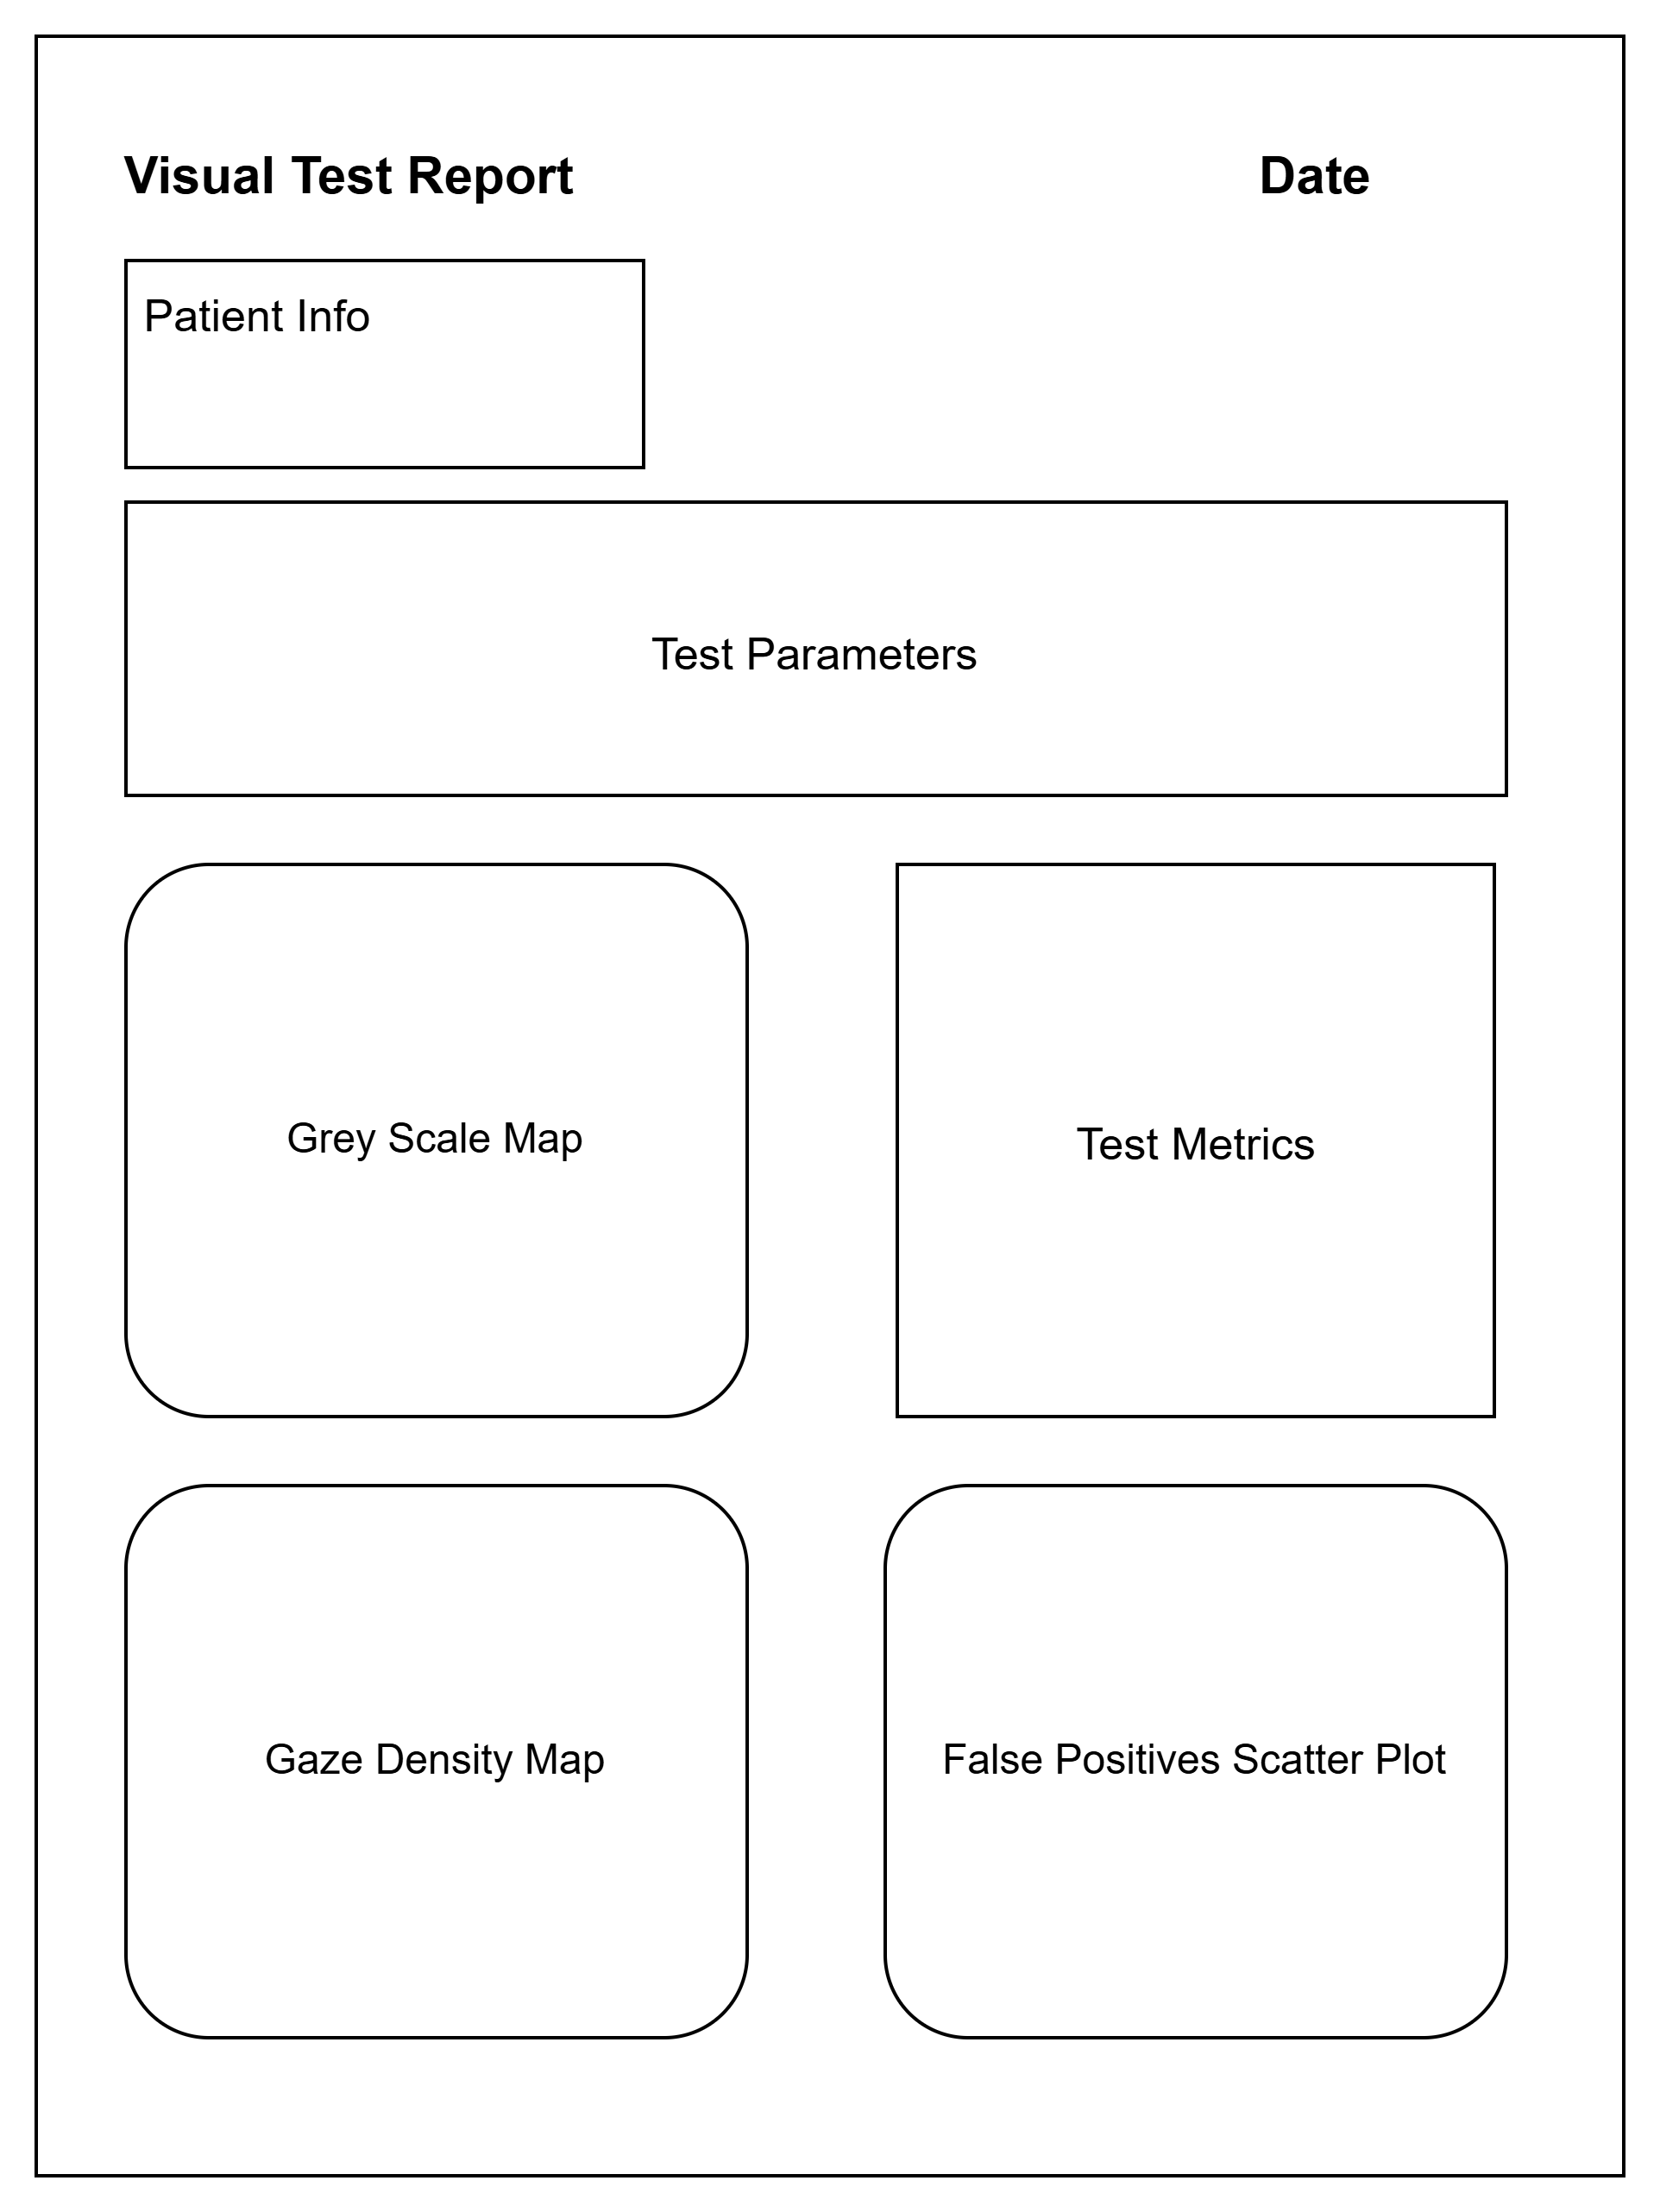
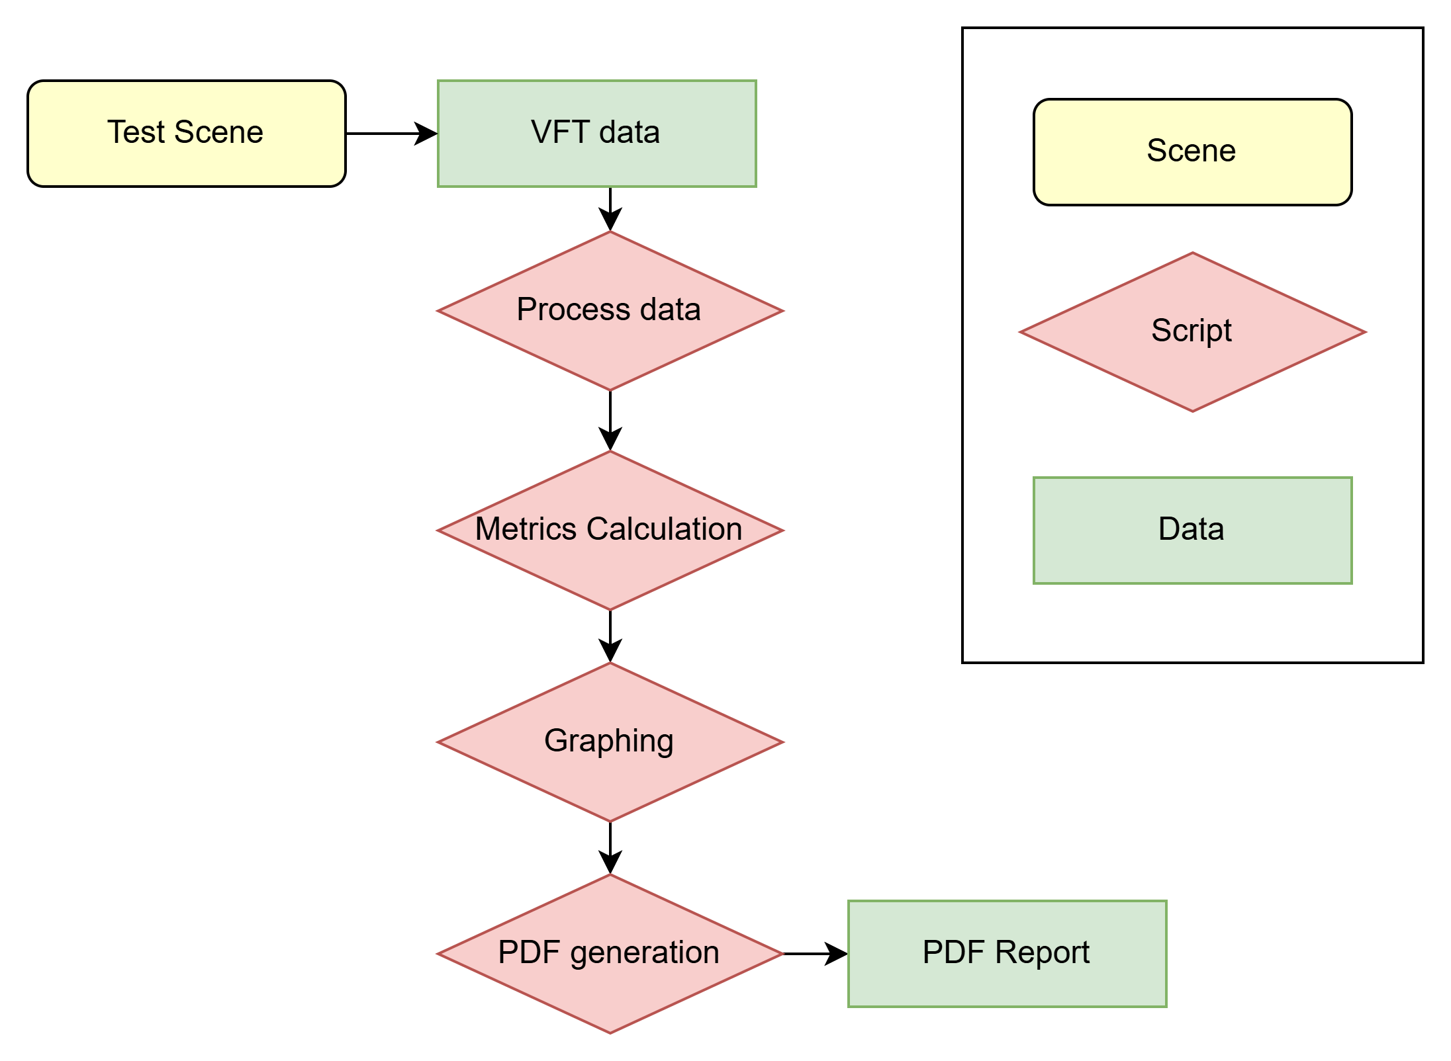
Report Generation
Report Generation Workflow
Report Generation Wireframe

Slide 12
Implementation

Slide 13






Hardware and Software
HTC Vive Pro Eye
Workstation:
CPU: Intel Core i9-12900K
GPU: NVIDIA RTX 3080 Ti
RAM: 64 GB
Unity:
Unity editor 2019
SRanipal SDK
Steam VR
Scripting:
VS code
Jupyter
Version Control:
Gitlab

Slide 14
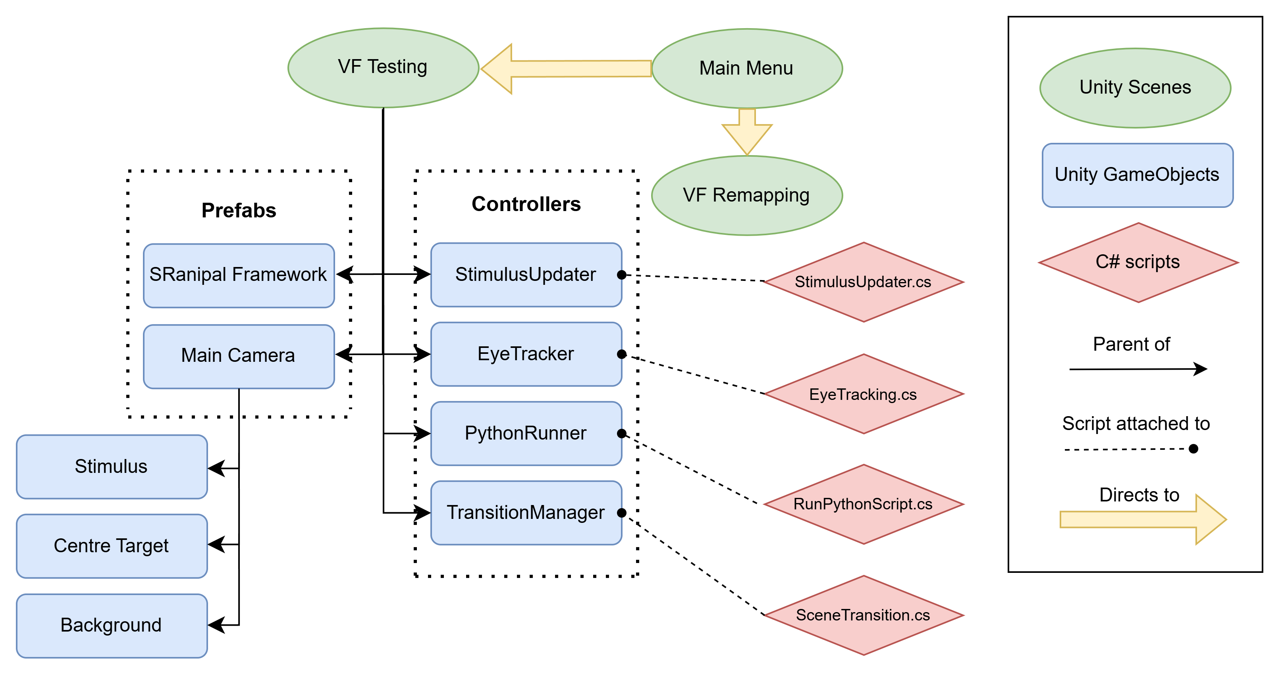
Unity Environment Hierarchy

Slide 15
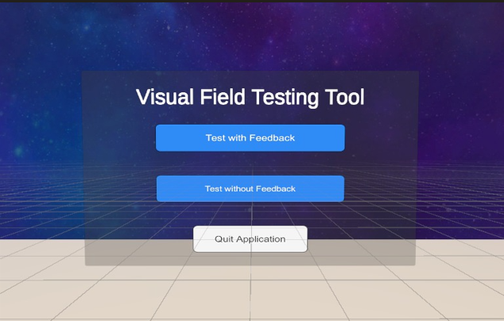
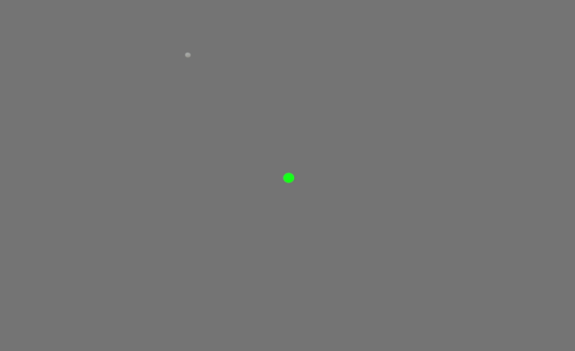
Environment
Flashing Stimulus
Centre Fixation Target
Menu Scene
VFT scene

Slide 16
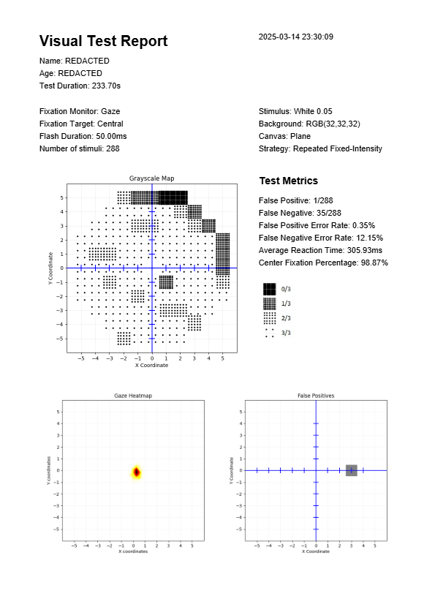
Generated Report

Slide 17
Evaluation

Slide 18
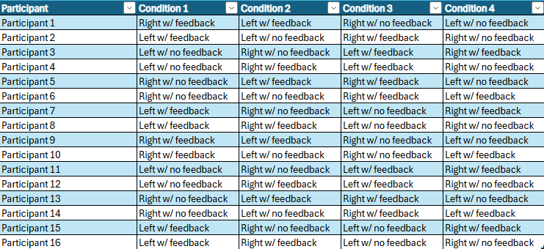
User Study (n=12)
Briefing & Calibration:
Participants were introduced to the system and completed eye-tracking calibration.
Counterbalancing
Latin square design varied eye (left/right) and feedback mode (on/off) to reduce bias.
Test conditions:
Condition A: with visual feedback
Condition B: without visual feedback
Data Collection
Reaction times, detection outcomes, and gaze data were logged. SSQ completed after each condition, followed by final form.
Latin Square

Slide 19
Results

Slide 20
Quantitative Data Analysis
Performed paired t-test:
Null hypothesis:
There is no difference in performance metrics between the two conditions.
Alternative hypothesis:
There is a difference between the two conditions (two-sided test).
Performance metrics:
Centre fixation percentage
Reaction time
False Positive rate
Negative rate

Slide 21
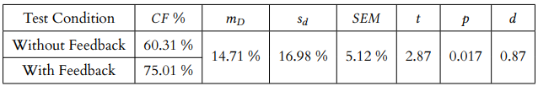
Center Fixation Percentage
Hypothesis: Real-time feedback improves centre fixation
Results (All Participants):
Slight improvement with feedback (p ≈ 0.071), not statistically significant.
After Removing Outlier (Participant 8):
Significant improvement (p ≈ 0.017), large effect size (d ≈ 0.87).
Supports the hypothesis that visual feedback enhances fixation.

Slide 22
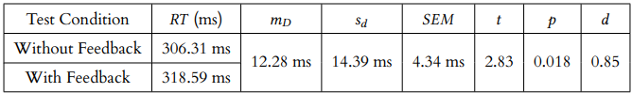
Reaction Time
Hypothesis: Feedback would lead to faster responses.
Results:
With feedback: 318.59 ms
Without feedback: 306.31 ms
Participants were ~12 ms slower with feedback
(p ≈ 0.018, d ≈ 0.85).
Feedback had a statistically significant but opposite effect than expected.

Slide 23
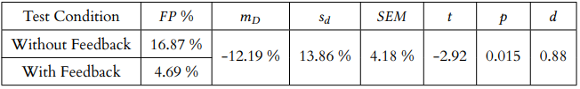
False Positive Rate
Hypothesis: Feedback reduces button presses when not fixating.
Results:
-12.19% decrease in false positives with feedback.
Statistically significant (p ≈ 0.015), moderately large effect (d ≈ 0.88).
Feedback improves response accuracy.

Slide 24
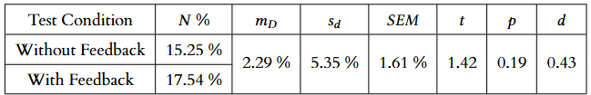
Negative Rate
Hypothesis: Feedback has no negative effect on detection accuracy.
Results:
Negative rate slightly increased with feedback.
Not statistically significant (p ≈ 0.124), medium effect (d ≈ 0.43).
Suggests a potential trade-off: improved accuracy but at the cost of missing some stimuli.

Slide 25
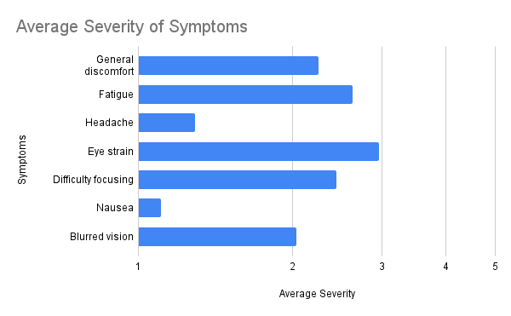
SSQ
Visual and cognitive load was present but well-tolerated
No participants discontinued the test
Design features (neutral background, short sessions, rest breaks) effectively minimised simulator sickness

Slide 26
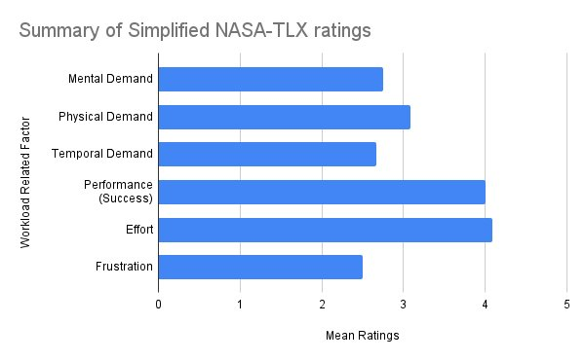
NASA TLX
The task was moderately demanding, but well-tolerated
Participants felt successful, focused, and committed
Supports the test’s suitability for short-term use in VR environments

Slide 27
Qualitative Feedback
Instruction Clarity
100% found the instructions very clear
Focusing on Centre Target
33% found it easy
50% were neutral
17% found it difficult
Visual Feedback Usefulness
75% found it helpful for maintaining focus
25% found it distracting, preferring fewer visual cues
Overall Experience
Most participants found the test interesting and engaging
41.6% also reported it to be tiring

Slide 28
Conclusion

Slide 29
Summary
Developed a VR-based visual field-testing system using consumer-grade hardware with built-in eye tracking.
Aimed to provide a cost-effective, accessible alternative to traditional clinical perimetry tools like the Humphrey Field Analyser.
Built using Unity’s Model-View-Controller pattern, integrating:
User interface
Stimulus generation
Real-time fixation feedback
Structured data logging

Slide 30
Key Findings
Quantitative
Real-time visual feedback
improved fixation (+14.71%, p = 0.017)
reduced false positives (-12.19%, p = 0.015).
Reaction time slightly increased (+12.28 ms, p = 0.018), suggesting possible cognitive load.
Negative rate increased slightly but were not statistically significant.
User Experience
Participants rated the system as comfortable and tolerable.
Low simulator sickness, with moderate eye strain and fatigue.
Users reported feeling successful and engaged throughout testing.

Slide 31
Further Research
Advance Testing Algorithms
Integrate dynamic methods like ZEST to estimate detection thresholds
Brightness Calibration
Develop hardware-based brightness calibration using photometers or sensors
Advanced Eye-Tracking Features
Add dynamic gaze correction and gaze-based fatigue analysis
In-App Tutorial & User Guidance
Use adaptive training sessions to reduce early testing errors
Clinical Validation Studies
Conduct trials comparing performance with clinical standards
Visual Field Remapping Modules
Develop corrective tools for users with deficits, enabling rehabilitation and visual correcting

Slide 32
Demo

Slide 33
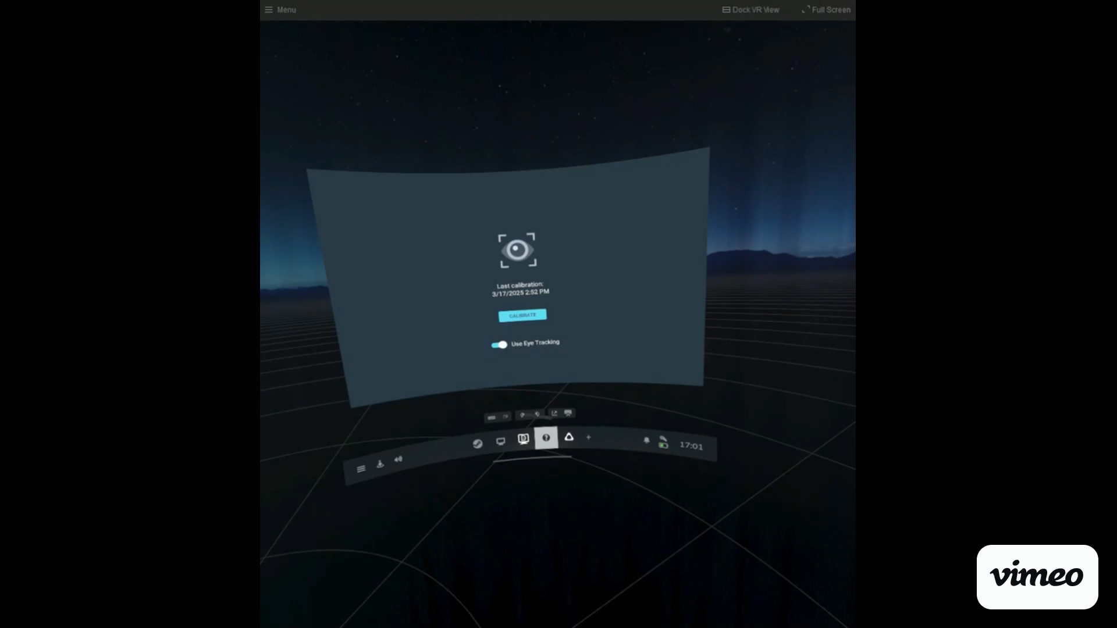
Demo

Slide 34
Any Questions?

Slide 35




Thank you!
@UofGlasgow

